Slide 1
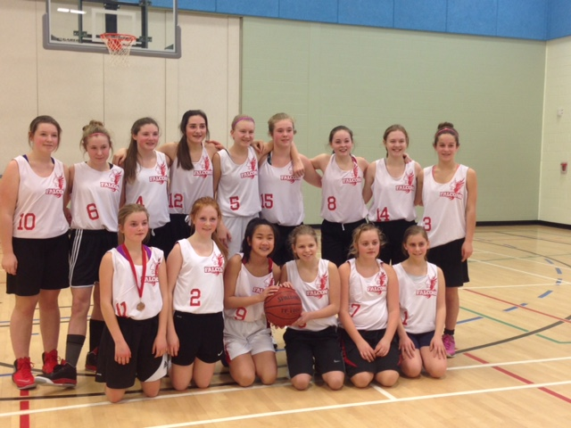
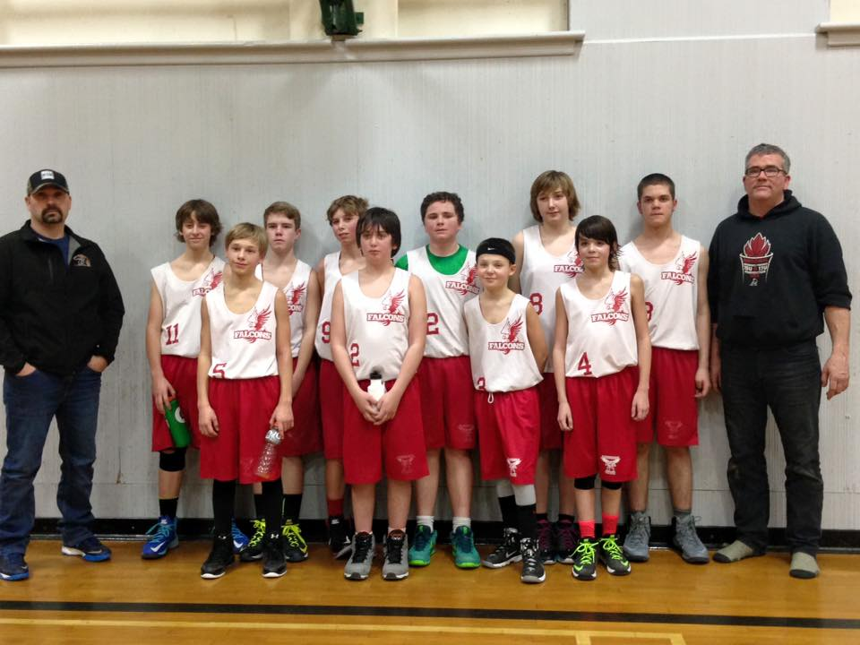
@ FMS - 7pm - $2 each
Girls vs. Boys
Thursday, March 3rd
All funds raised to be used for Grade 8 Quebec trip

